Slide 1
Heart Disease using ML Models
Suniksha Gupta
Data Science Capstone Project

Slide 2
Abstract
Heart disease is one of the leading causes of death worldwide, making early detection crucial for effective prevention and treatment. This project aims to develop a machine learning model to predict the likelihood of heart disease using patient health indicators such as age, blood pressure, cholesterol level, BMI, diabetes status, lifestyle habits, and other cardiovascular risk factors.
Exploratory Data Analysis (EDA) was conducted to understand patterns, detect missing values, and identify relationships between health variables and heart disease outcomes. Multiple machine learning algorithms were trained and evaluated using classification metrics such as accuracy, precision, recall, and F1-score.
The results demonstrate that machine learning models can successfully identify individuals at higher risk of heart disease by analyzing complex medical data. This approach highlights the potential of data-driven methods to support early diagnosis and improve decision-making in healthcare.

Slide 3
Need for Project
Heart disease is one of the leading causes of death worldwide, making early risk detection extremely important.
Many health factors such as age, blood pressure, cholesterol, diabetes, stress, and lifestyle habits influence heart disease risk and are difficult to assess manually.
Predicting heart disease at an early stage can help individuals take preventive actions and adopt healthier lifestyles.
Machine learning can analyze large medical datasets and identify hidden patterns that may not be obvious through traditional analysis.
A reliable prediction model can assist healthcare professionals in making faster and more accurate decisions for patient care and risk assessment.

Slide 4
Proposed System
Collect patient health data including features such as age, gender, blood pressure, cholesterol level, BMI, diabetes status, smoking habits, and lifestyle factors.
Perform data cleaning by handling missing values, removing duplicates, and correcting inconsistent entries.
Encode categorical variables (such as gender, exercise habits, and smoking status) into numerical format for model training.
Conduct exploratory data analysis to understand feature distributions, correlations, and patterns related to heart disease.
Apply feature engineering and scaling techniques to improve model performance.
Split the dataset into training and testing sets for proper model evaluation.
Train multiple classification models (Logistic Regression, Random Forest, KNN, etc.) and compare their performance.
Select the best-performing model and tune hyperparameters to improve prediction accuracy.
Use the final model to predict the likelihood of heart disease and identify key risk factors.

Slide 5
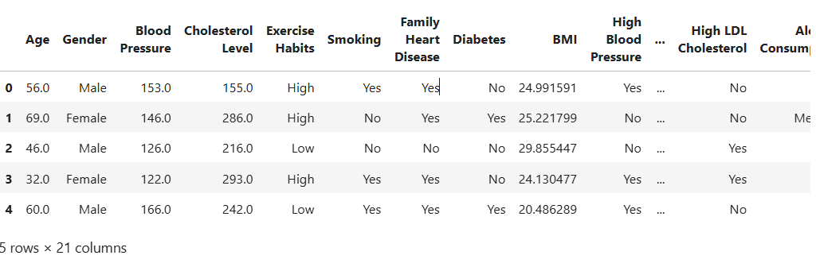
Snapshot of Data
The following snapshot shows the head of the data taken from Dataset used in Heart Disease

Slide 6
Dataset Description
Dataset Size: 10000 x 21
Following are the parameters in dataset for Heart disease:
Age
Gender
Blood Pressure
Cholesterol Level
Exercise Habits
Smoking
Family Heart Disease
Diabetes
BMI
High Blood Pressure
Low HDL Cholesterol
High HDL Cholesterol
Alcohol Consumption
Stress Level
Sleep Hours
Sugar Consumption
Triglyceride level
Fasting Blood Sugar
CRP level
Homocysteine level
Heart Disease status

Slide 7
Pipeline
Data Collection
Data Cleaning and Pre-processing
Exploratory Data Analysis (EDA)
Feature Selection/ Feature Engineering
Train-Test Split
Model Training
Model Evaluation
Final Model Selection

Slide 8
Data Cleaning and Pre-processing
The main aim of Data Cleaning is to identify and remove errors and duplicate data, in order to create a reliable dataset.
The process of data cleaning is done by using a very famous library pandas.
Initially those columns/features and values (non-relevant) are dropped from our dataset which showed only null values in the entire column.
The rows having a null value in any columns are dropped from our dataset.
The columns having character as well as integer values are converted into integer values only.
Many more data cleaning techniques are used to improve the quality of our dataset.

Slide 9
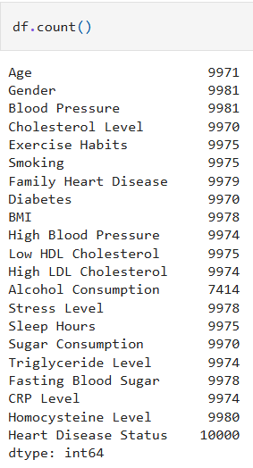
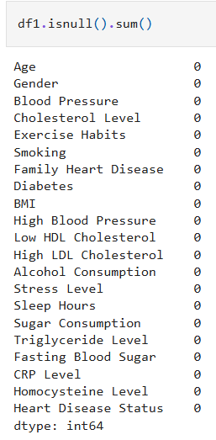
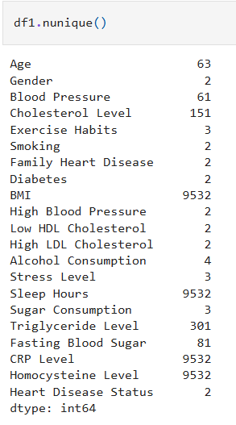
Data Cleaning and Pre-processing

Slide 10
Data Visualization and EDA (Exploratory data Analysis)
Exploratory Data Analysis (EDA) helps us understand the data before building any model.
It includes visualizing patterns, trends, correlations, and identifying outliers or unusual values.
EDA allows us to see which features influence heart disease the most.
Visual charts like histograms, box plots, pair plots, and correlation heatmaps make it easier to interpret relationships in the dataset.

Slide 11
In the next few slides, I will show some of the important plots and relationships among data.

Slide 12
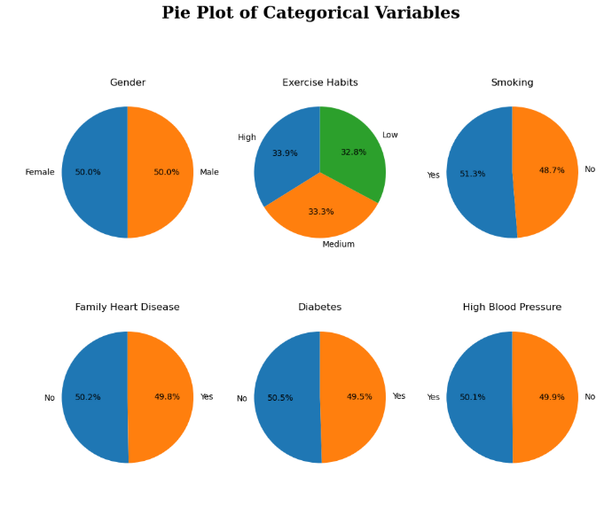
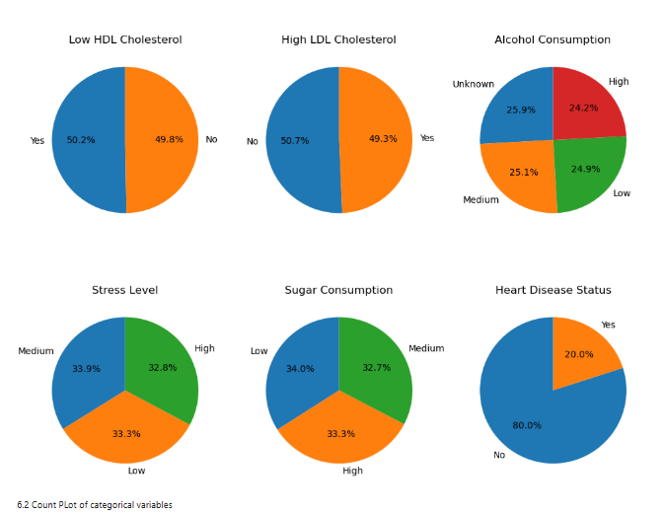
Data Visualization

Slide 13
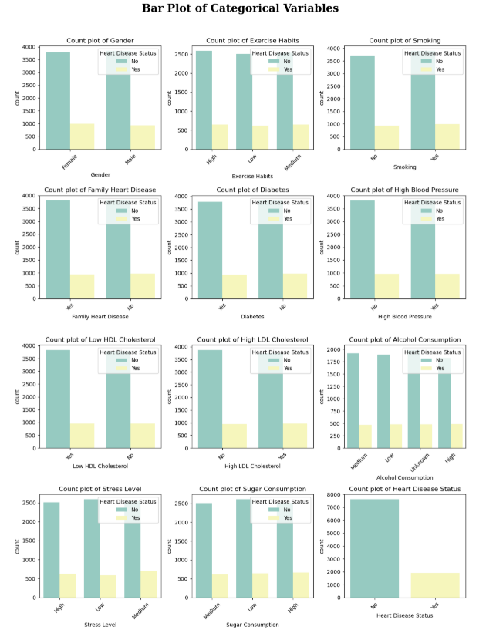
Data Visualization

Slide 14
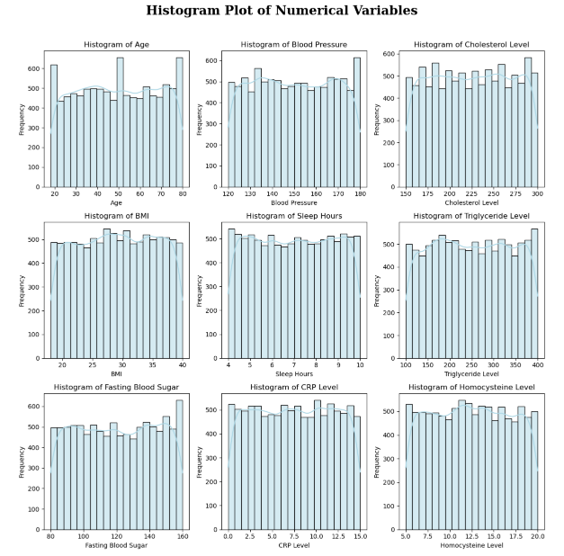
Data Visualization (Outlier Detection)
Histogram of all numerical feature

Slide 15
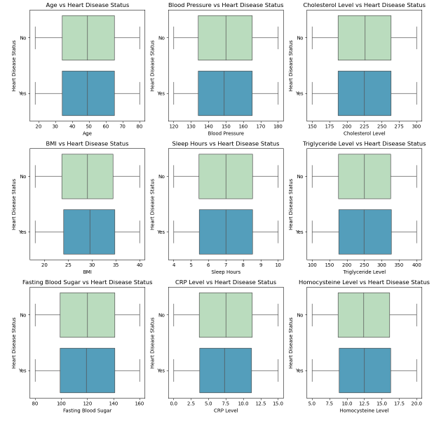
Data Visualization
Categorical Column vs Target

Slide 16
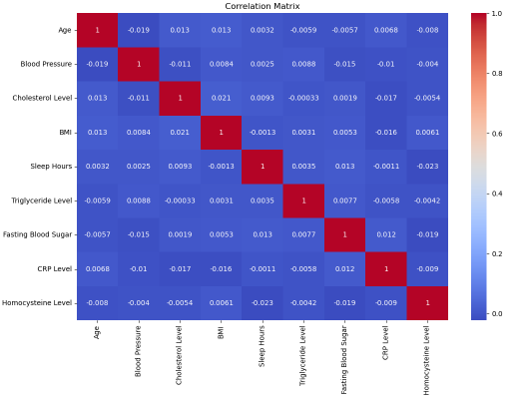
Data Visualization
Correlation of Numerical columns with Heart Disease:

Slide 17
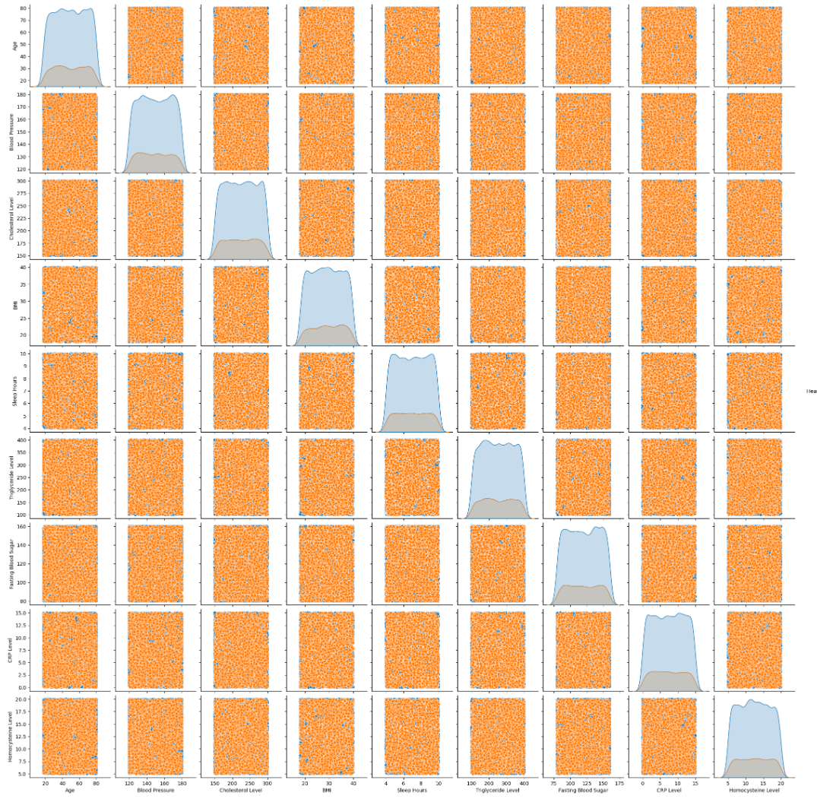
Data Visualization

Slide 18
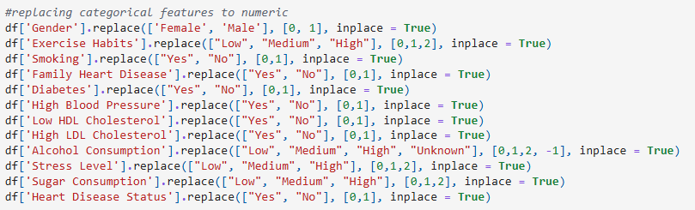
Dummy or indicator features for categorical variables
Data Visualization
This technique is used to convert the categorical variables into numeric values.

Slide 19
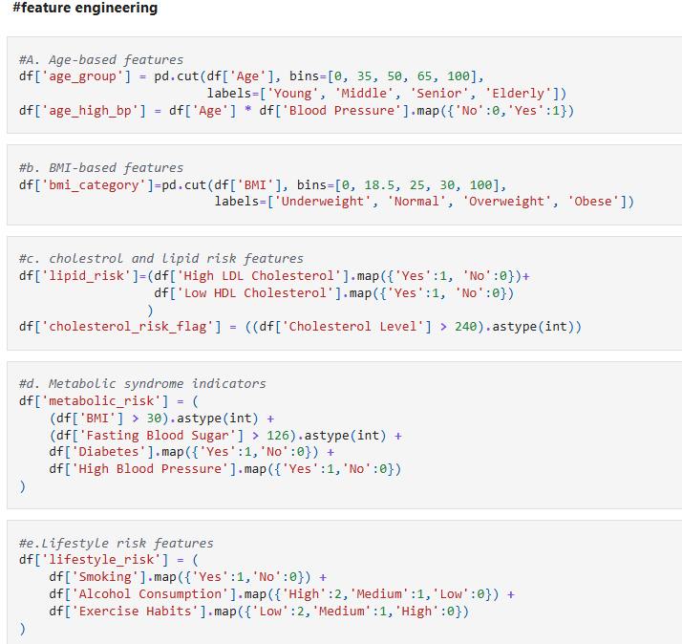
Feature Engineering
Feature engineering is the process of using domain knowledge to extract features from raw data via data mining techniques. These features can be used to improve the performance of machine learning algorithms. Feature engineering can be considered as applied machine learning itself.

Slide 20
Machine Learning Algorithm
We set the independent and target variables as X and Y respectively.
Split the dataset into training and testing set in 80:20 ratio.
Fitting the train set to multiple models (Logistic Regression, Random Forest, K nearest neighbours) and getting the score on test set.
Calculated the Precision, Recall, F1 Score and accuracy score and compared the same for each model.
Calculated the mean of Cross-Validation score for training and test set and compared the same for each model.
Lastly completed the modelling by applying Random Search and Grid Search for Hyperparameter tuning

Slide 21
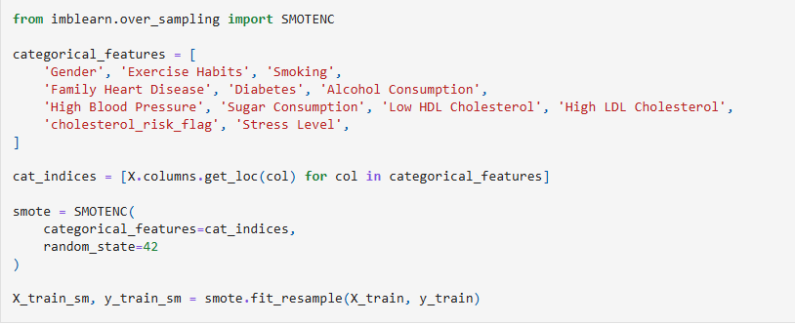
Handling Class Imbalance using SMOTENC
The dataset shows class imbalance in the target variable (Heart Disease Status). To address this issue, we apply SMOTENC (Synthetic Minority Oversampling Technique for Nominal and Continuous features).
SMOTENC is specifically used because the dataset contains both categorical and numerical features.

Slide 22
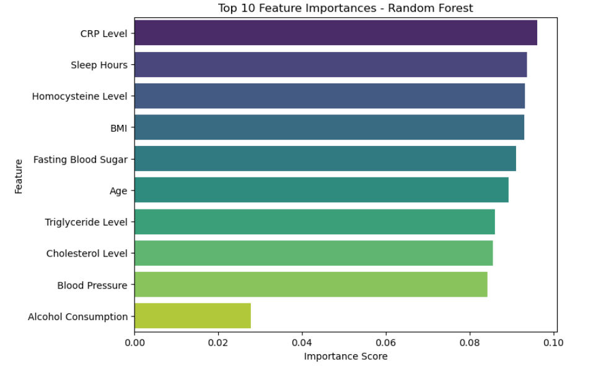
Feature Importance from Random Forest

Slide 23
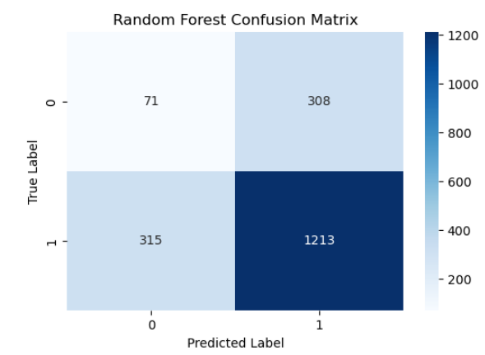
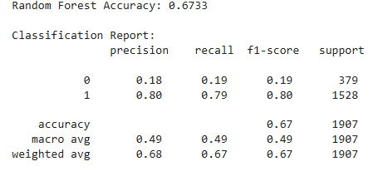
Machine Learning Algorithm
Random Forest confusion matric and classification report

Slide 24
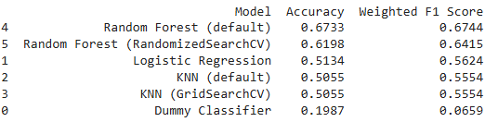
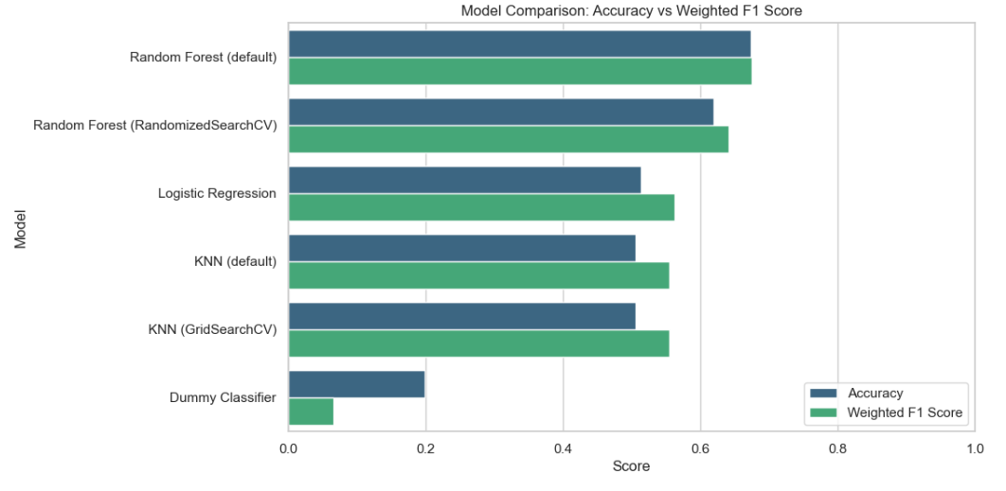
Machine Learning Algorithm
Comparison of Algorithms

Slide 25
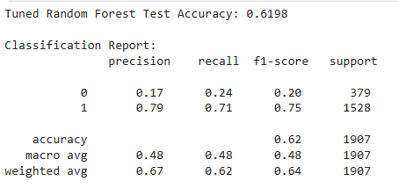
Random Search Cross Validation
This is a techniques used to find the best parameters for our machine learning model.
Parameter tuning for Random Forest: Best parameters came out to be:
Model Metrics for Random forest after fitting the best parameters obtained from Random Search

Slide 26
Key Findings from the Project
Data & Feature Insights
Patient data revealed certain features like age, cholesterol, blood pressure, and max heart rate had the strongest correlation with heart disease.
Lifestyle factors (smoking, physical activity, BMI) and family history also significantly influenced risk.
Some features exhibited skewed distributions (e.g., cholesterol levels), requiring normalization for modeling.
Model Performance Insights
Linear models (Logistic Regression) showed moderate accuracy (~0.52), struggling with non-linear interactions between risk factors.
Ensemble models performed better:
Random Forest Accuracy: 68
Cross-validation indicated low variance, suggesting good generalization across patient subgroups.
Final Tuned Model Results
Tuned Random Forest model achieved:
Accuracy: 0.62
Precision: 0.79, Recall: 0.71, F1 Score: 75
Metrics confirm high predictive accuracy, strong sensitivity to detecting heart disease, and robustness across patient demographics.

Slide 27
Conclusion - Heart Disease Prediction Project
The project successfully developed a robust and accurate predictive model for heart disease risk estimation.
Systematic steps including EDA, encoding, feature engineering, scaling, model training, evaluation, and hyperparameter tuning produced a high-performing final model.
The optimized KNN/ Random Forest model effectively captures complex, non-linear interactions among patient risk factors, providing reliable predictions.
This model provides a strong foundation for:
Clinical decision support for cardiologists and primary care physicians
Early detection and risk stratification of patients
Development of automated patient screening or diagnostic tools
Personalized preventive strategies and lifestyle recommendations

